Slide 1

DL Assignment 2 Problem 2
Done by: Suen Jeren (S10204092)

Slide 2
Table of Contents
Problem and approach
Data loading and processing
Develop models
Text generation with models

Slide 3
Problem and approach
Implement RNN to create an English language character generator
Training models to generate text automatically, character by character
We will be developing various sequence generator models with GRU, LSTM and Conv1D and finding the model with the best performance
We will then use the best model for our language character generator

Slide 4
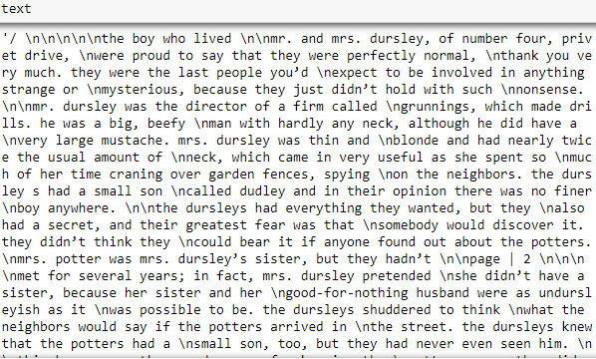

Loading and cleansing data
Taking note of irregular texts to be removed
Words such as “\n”, punctuation, stop words, “Page |”
Manually removing the title in each page from .txt file
Removing these words as they play no part in text generation

Slide 5
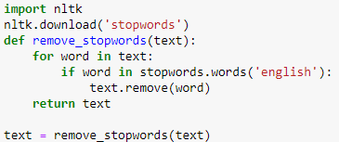
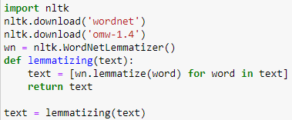
Removing stop words/ Lemmatizing
Stop words are words that are generally filtered out before processing
Most common used words, but also render to be the most redundant
Lemmatizing is grouping together different forms of the same word.

Slide 6
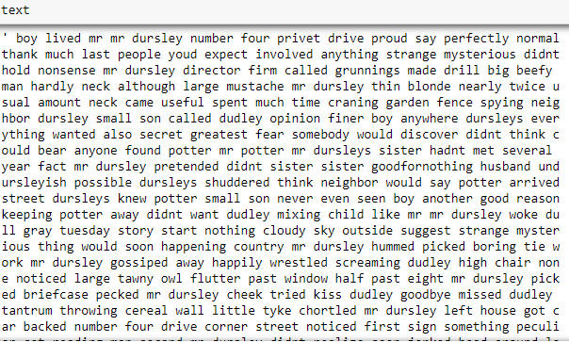
Text processing – Before & After
Before
After

Slide 7
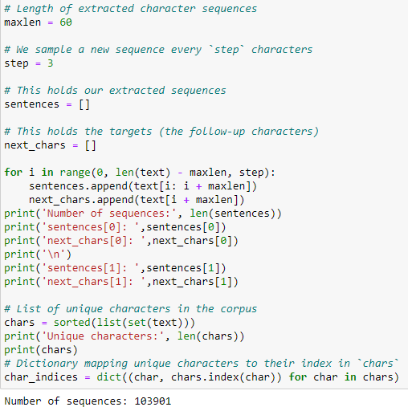
Preparing data & one-hot encoding
Since our data is a big text file and not multiple rows of data, we will have to make the data ourselves
By specifying a maxlen and step, we are essentially splitting our text into multiple rows of 60 characters with a difference of 3 characters per row.

Slide 8
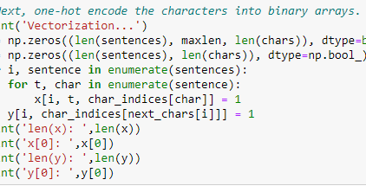
We then one-hot encode the data into a 3D numpy array
Create an array y containing the one-hot encoded characters that come right after each extracted sequence

Slide 9
Comparisons of different models made
Model | Validation Accuracy | Validation Loss
GRU model 1 | 0.4497 | 2.314
GRU model 1 (After Tuning) | 0.5039 | 1.6287
GRU model 2 | 0.5059 | 1.6778
GRU model 2 (After Tuning) | 0.5102 | 1.6256
Conv1D model 1 | 0.4044 | 2.6348
Conv1D model 1 (After Tuning) | 0.4390 | 1.9668
Tuned Conv1D model 2 | 0.4401 | 2.0554
Tuned LSTM model | 0.4962 | 1.6551
After comparing the performance of all the models, our GRU model performed the best
We used our GRU model for text generation

Slide 10
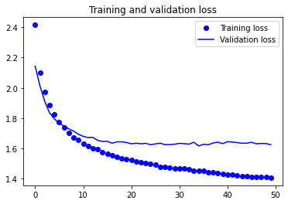
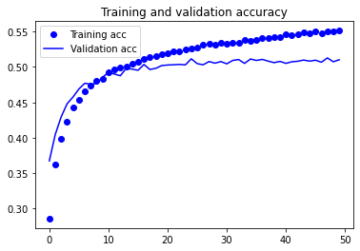
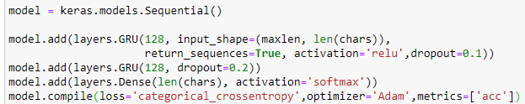
Best model with GRU
Our best model has 2 GRU layers with a dropout of 0.1 and 0.2, respectively.
From our training and validation, we can see that there is no overfitting observed, but our training and validation is getting further away from each other
Accuracy is high at 51%

Slide 11
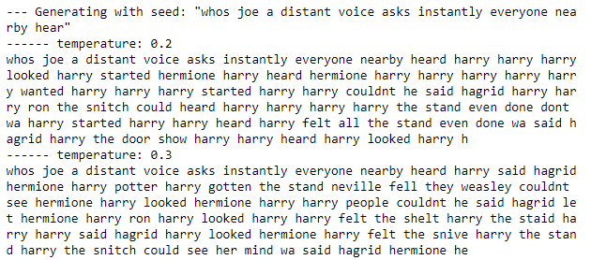
Lower temperatures
In lower temperatures, we can see words are very repetitive
“harry” repeatedly comes up numerous times
Word structure is highly realistic – most of generated text are real English words/words from our data

Slide 12
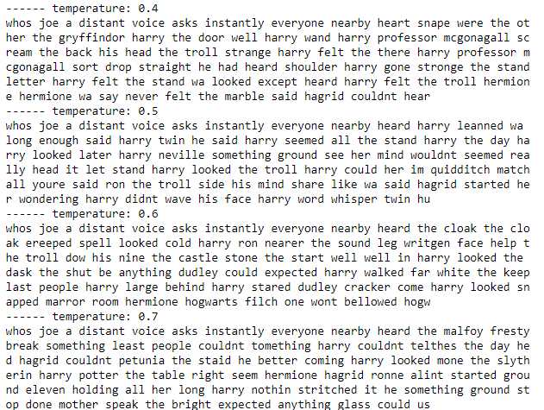
Middle temperatures
For temperature ranges of 0.4 to 0.7, we can see more interesting words
In 0.4 we still can see a fair amount of repetition for words “harry”
Higher temperatures can see text generation really good, most words are English and generation is creative
Creates new interesting words like “fresty” and “petunia”

Slide 13
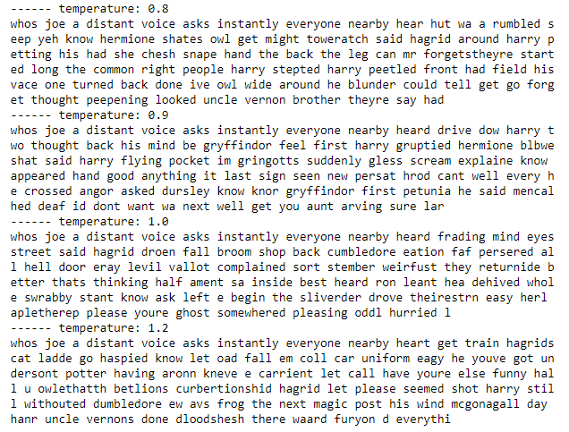
High temperatures
Word generation starts to get messy and erratic
Longer words being generated, even though they do not make sense
More string – like compared to being words

Slide 14
Overall observations
In lower temperatures, generated text is often extremely repetitive and predictable, but have highly realistic local structure
With higher temperatures, words generated becomes more interesting, surprising and even creative
Can sometimes create completely new words that sound somewhat plausible.
Local structure in higher temperatures starts to break down, with most words looking like semi-random strings of characters
Without a doubt, the range of 0.5 to 0.7 boasts the most interesting find

Slide 15

Findings
When training our models, GRU model takes from 60 seconds to 200 seconds
Conv1D models takes an average of 10-30 seconds per epoch, yet have decent accuracy of 44% - which will take GRU about 50 seconds per epoch to run
LSTM model can keep up well with our GRU model but can do better if our dataset had 20-30 characters instead of 60 characters per row.

Slide 16

Further improvements
Could have tuned final model better
Text cleansing can be improved, as many words has been messed up after stop words was removed and text was lemmatized
Train bigger models with more epochs + higher quantities of data to achieve better generated sampling
Try out more RNN types, add embedding layers and implement functional API
Supposedly cleansed text

Slide 17
Thank you

